Slide 1
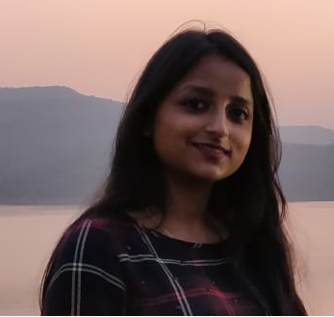
Smriti Agarwal 11695635 smriti.agarwall@accenture.com Phno|8601725748
Background
Relevant Experience
Application Development & Analyst with 2.5 years of experience in Mainframe development with Health Insurance client.
Have gained good knowledge in requirement analysis and defect resolution.
Adaptable to work both as a team member as well as independently.
Excellent communication Skills.
Worked In various development projects with a good exposure in requirement analysis, Debugging and implementation.
Design, build and configure applications to meet business process and application requirements
Knowledge and experience in more than one recognized development methodology example :Agile and Waterfall methodology.
End-to-end flawless component deliveries, resolving live defects.
Adhere to coding standards.
Coordinating with Onsite counterparts/SME for gathering information/clarification about requirements.
Creating Unit Test Plans based on Identified Code change.
Worked on Batch modules, Online modules and Stored Procedures.
Code migration to different environments.
Knowledge transition and demos with client.
Involved in Product Support activities such as resolving real time abends, monitoring jobs, taking reports.
EPDB application generally maintains the database of providers. It interacts with the different application, interfaces like Claims, DSE, SFE and provides the requested information to them.
[Client : ] Aetna Inc, Hartford CT, USA
Qualification & Skill Summary
Educational Background: | B. Tech(Electronics and communication)
Technical Expertise:
Achievements /Trainings:
Technical skills -COBOL, JCL, DB2, CICS
Database - DB2
Tools - Endevor,
Xpeditor
Abend Viewer
IBM Data Studio,
File Aid
SDLC -Well versed in Agile Methodology as well as waterfall.
Scheduler - Zeke
Training in Mainframes.
Awarded in my previous organization for excellent contribution in project and working with client directly and independently.
Previous Project information

